Slide 1
Project 2: Ames housing price prediction

Slide 2
Problem Statement
This project aims to predict the sales price of houses in Iowa, Ames
It seeks to explore trends and valuable information from the data
to give an edge to both home buyer and seller
To give insights to home buyer so that he/she can make informed decisions
when making house purchase
For house sellers to gain knowledge on how to increase their house value,
when to sell and also to match expectation to the price based on data

Slide 3
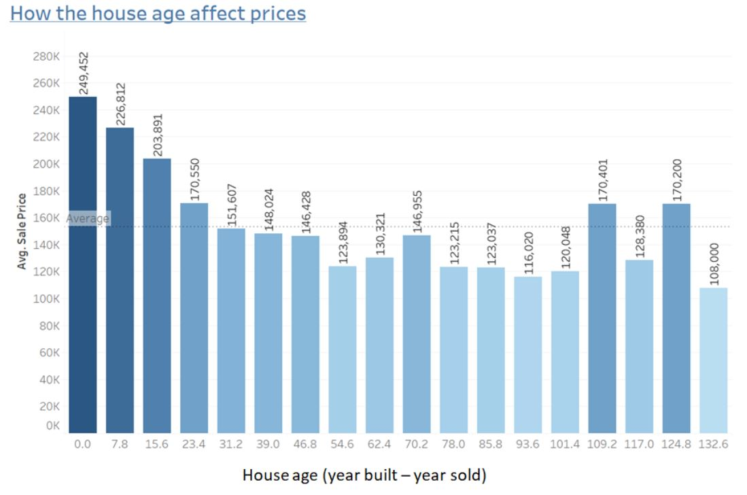
How does house age affects sales price?
In general , lower house age translates to higher prices but there are 2 groups of houses that are above 100 years of age was still able to get above average prices

Slide 4
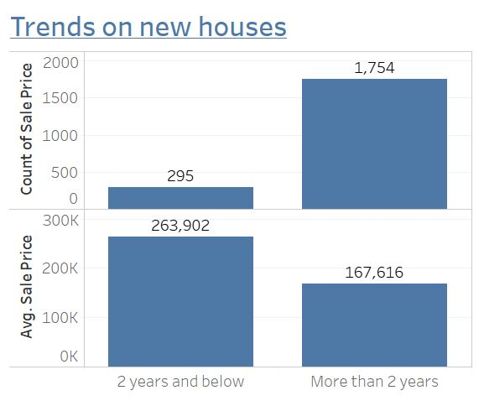
Trends on new houses(2 years and below)
New houses are not really popular. For houses that are 2 years of age or under, they are just 295 counts or about 7% of the total. The average price for new house are almost 100k above the average house prices which could explain the unpopularity

Slide 5
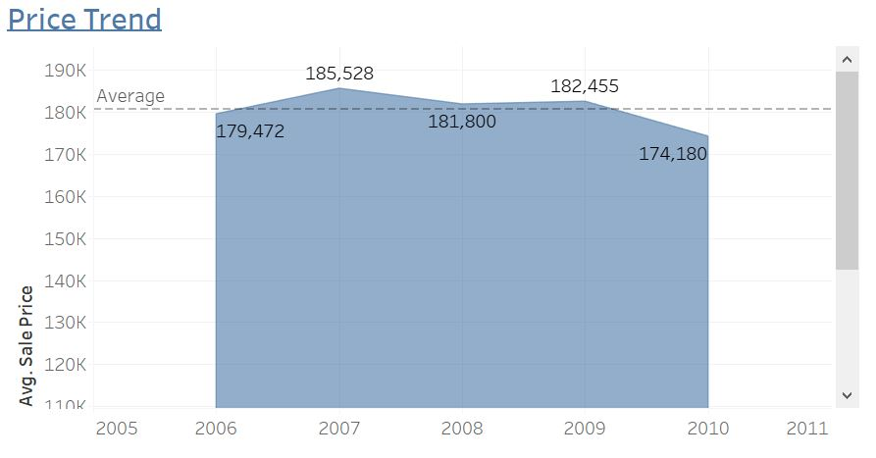
House prices trend investigation
Ames house prices peaked at 2007 and as the US housing market crash in 2008, the following years was on a downward trend. If economy recovers, housing price tend to appreciate. The period around year 2010 could be a good opportunity for buyers to buy house at bargain price

Slide 6
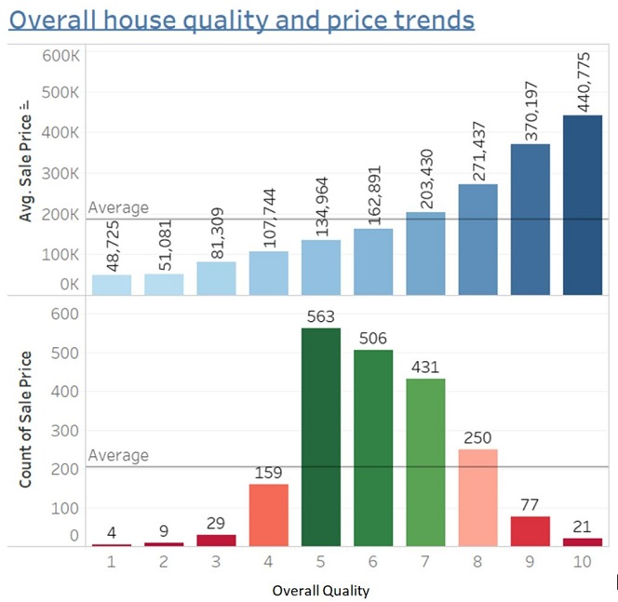
Overall house quality and sale price
Houses with higher overall quality has a constant upward trend of being more expensive. On the other hand, it is observed that not every house buyer is willing to pay top dollar for top end quality, most buyers usually settles for a house at a mid-high level (5-7), in essence finding a balance between the house an a house of reasonable quality. Low quality houses are definitely frowned upon.
House sellers should definitely look towards re-modelling their house , but it might not be worthwhile to over-spend as not many buyers are looking at the top quality range

Slide 7
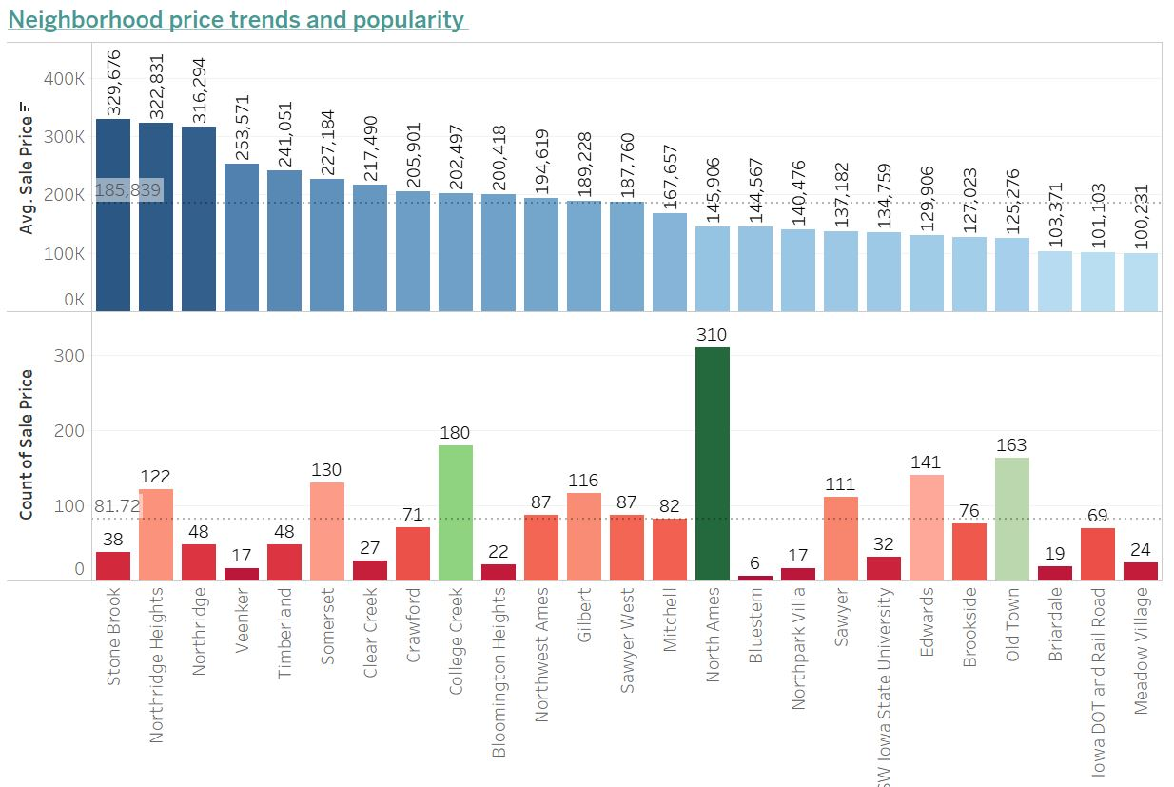
Neighborhood price trends and popularity
North Ames, College Creek and Old Town stand out on popularity. 3 out of 2 are below average sales price, only with College Creek a slightly above the average price. The most pricey neighborhoods are: Stone Brook, Northridge Heights and Northridge. All 3 have average sale price above 300k which significantly higher than the 185k average. At said, they are not popular. The above 2 observations looking at neighborhood popularity and most pricey neighborhoods draw a conclusion that house price is most important determinant factor for house sales.

Slide 8
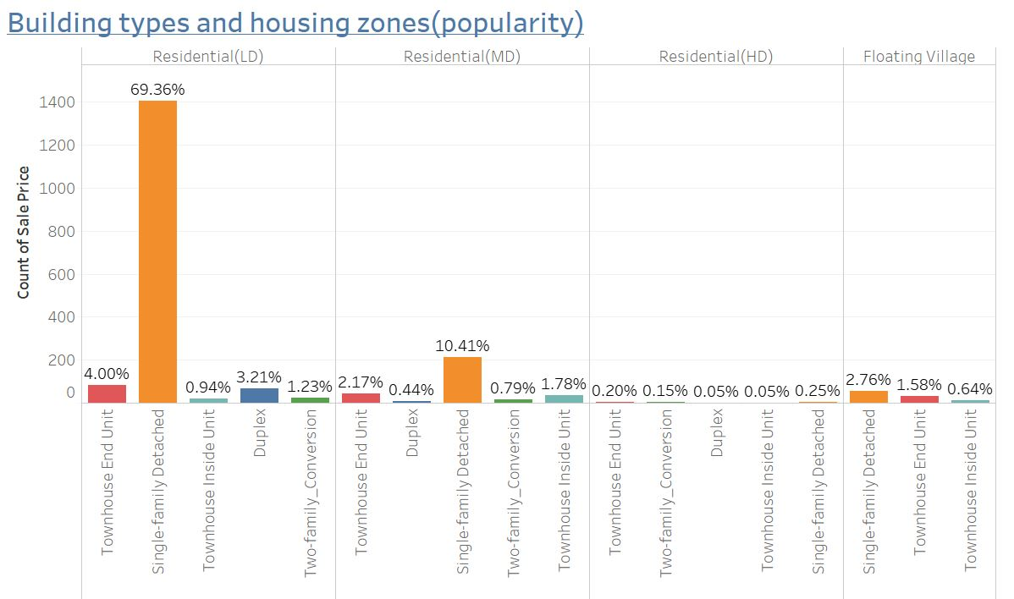
Building type and housing zones
House buyers favor single-family detached which stands out among the rest at 70%. Personal privacy is important to house buyers. We see that houses in lower density residential area are preferred even though they command a slightly higher average price as compare to medium and high density ones.

Slide 9
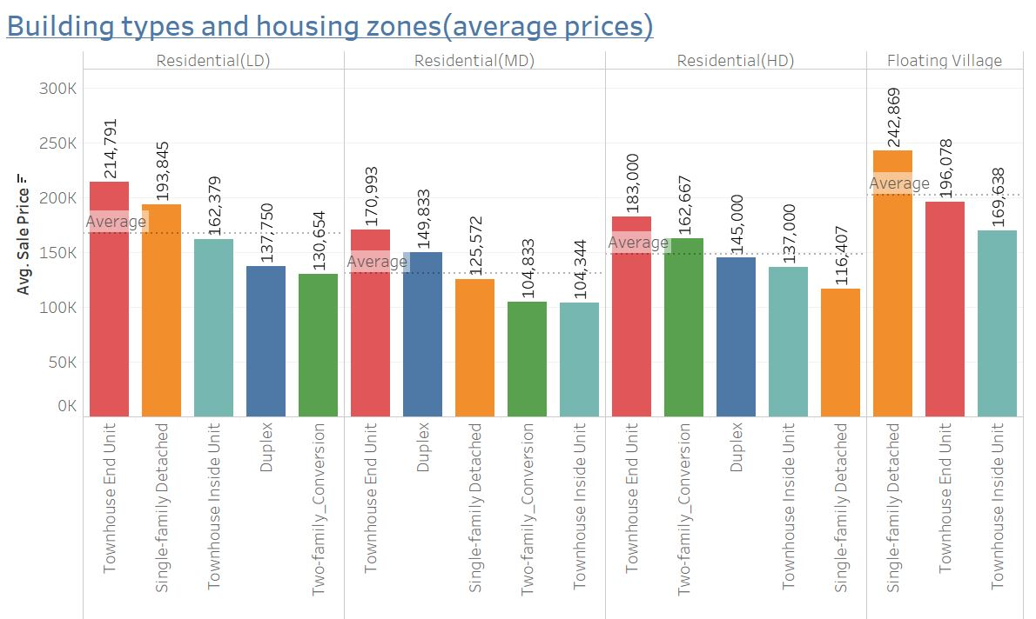
Building type and housing zones – Cont’d
We see that houses in lower density residential area are preferred even though they command a slightly higher average price as compare to medium and high density ones.
Townhouses are the most expensive. Again, it is no surprise that they are not as popular

Slide 10
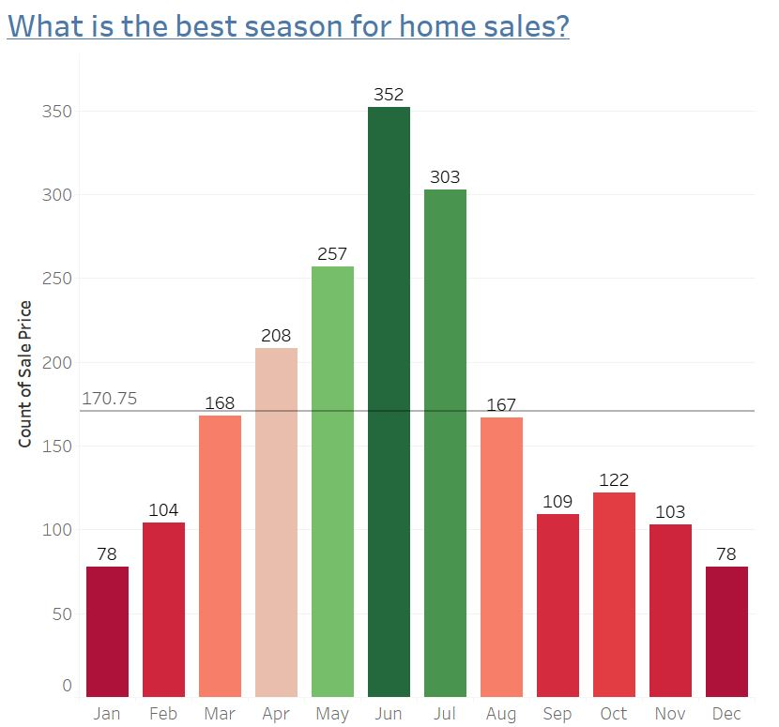
Seasonality and house sale price
House sales peak during summer months (May to July). Sellers should try to sell their property during this period

Slide 11
Findings and recommendations
Square feet area, condition, age, and the location of the house are
the most important determinant factors of sale price
In generally, the lower the house age, the higher the price, so sellers
looking to sell should act quick rather than to wait
Home sellers should also look into renovating their house to get better sales price but not overspend as there are fewer buyers for house in the top quality range
Home sellers should target summer months to sell their homes

